Slide 1
Switchable Radio over Fiber System for Low-Cost Operation of Multiple RF Inputs
Group 10

Slide 2




Team Members
Edgar Nino (EE)
Francisco Hernandez (EE & PSE)
Justin Gruber (PSE)
James Ko (CPE)

Slide 3
Project Motivation
Problem statement from sponsor
High speed communications hardware is expensive
In typical systems, need a full communication link for each RF band
Inefficient use of hardware
Especially if not all bands needed simultaneously
To solve this, we will implement optical switching in an RFoF link
MEMS fiber devices
Wavelength Division Multiplexing (WDM) used to selective direct signals
Asymmetric, 3 bands 2 receivers architecture

Slide 4
Project Goals
Basic | Advanced | Stretch
Utilize a Mach-Zehnder modulator to modulate signals up to 433 MHz Have a low bit error rate to enable essentially error-free communication Design 3x2 non-blocking optical switching system Implement simple modulation schemes such as FSK or OOK | Increase system bandwidth to 2.4 GHz Integrate the RF link with a software-defined radio interface Improve the signal-to-noise ratio in order to use higher-order modulation schemes Implement more advanced modulation schemes such as QPSK and QAM | Increase system bandwidth beyond detector bandwidth with heterodyne detection Extend the frequency range up to 12.6 GHz Integrate phased-array antennas to enable beamforming and adaptive beam steering for enhanced communication performance and coverage. Incorporate RF or optical circulators to allow the communication link to be full or half duplex

Slide 5
Project Objectives
Design/align
Diffraction grating-based wavelength division multiplexing system
2x3 optical switching mechanism based on 1x2 fiber-optic-based switches
Laser diode system to generate and efficiently couple light from the laser diodes to the switches
Photodiode system capable of measuring frequencies up to the system bandwidth
Use an optical modulator to modulate the intensity of light to carry an RF signal
Run tests to measure the bit error rate, data throughput, and system bandwidth
Obtain access to a lab with spectrum analyzers, VNAs, signal generators, and power sensors to test and troubleshoot RF amplifiers, transmitters, and receivers.
Perform a link budget analysis to ensure that the transmitted RF signals can be adequately detected at the receiving end
Simulate the RF photonic system in Simulink or Labview to analyze the system’s behavior

Slide 6
Engineering Specifications
Components | Specification | Values
Photodiode,Mach-Zehnder modulator, and RF filters | System Signal Bandwidth | 30 MHz to 5 GHz
Mach-Zehnder modulator and fiber optic | Data Transfer Rate | 1 GB/s
Link budget across all components | Signal-to-Noise Ratio (SNR) | 25 dB
RF filters and amplifiers | Spurious-Free Dynamic Range | 60 dB
Fiber optic | Transmission Distance | 2 km
Entire system | Bit Error Rate (BER) | < 10⁻³
Laser diodes | Wavelength Channel Spacing | 20 nm
Laser diodes | Optical Power Output | 15 mW
Entire system | Total System Power Consumption | <50 W

Slide 7
Engineering Specification (Continued)
Components | Specification | Values
1x2 Fiber Switch | Switching Time | < 25 ms
Laser diodes | Number of WDM Channels | 2
Diffraction Grating | WDM Free Spectral Range | 750 nm
Fiber collimating/focusing lenses | Fiber coupling losses | <1.5 dB @ 30 cm separation
Photodiode | Optical bandwidth | 1530-1625 nm (C+L bands)
Collimating lens | Collimated Beam Size | < 3 mm
Collimating lens | Coupling losses | < 1.5 dB
Multiplexing system | Size | 10x10x10 cm
Entire System | Total system cost | < $15,000

Slide 8
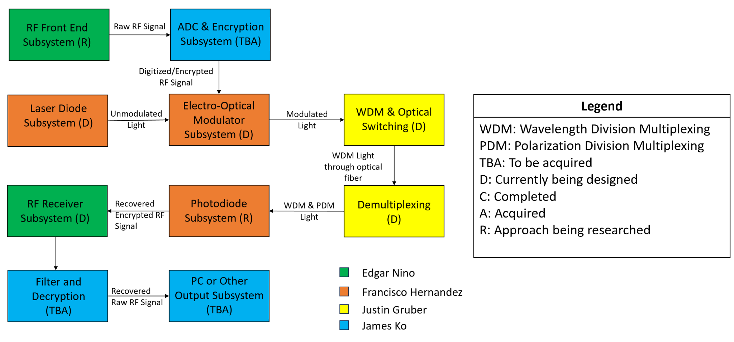
Hardware Block Diagram

Slide 9
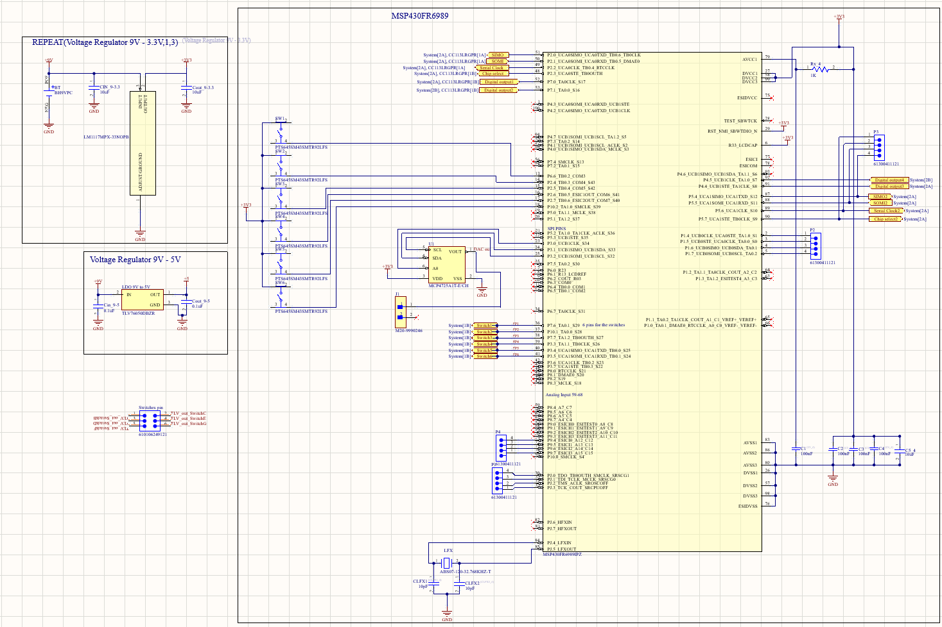

Slide 10
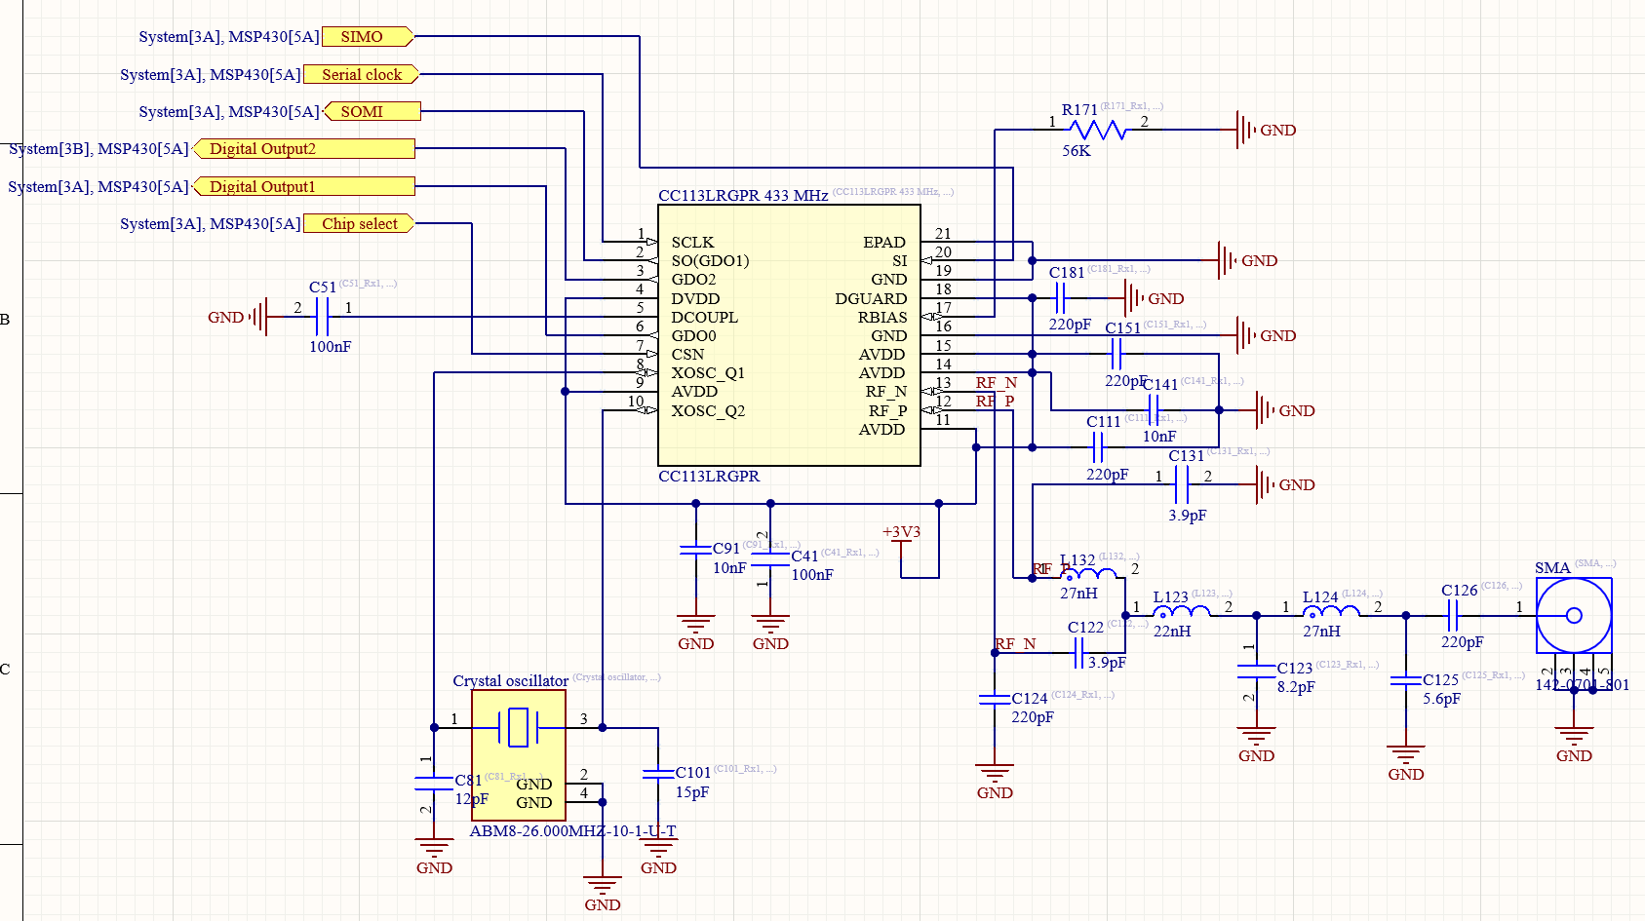
Radio Receiver
RF balun
Balanced to unbalanced signals

Slide 11
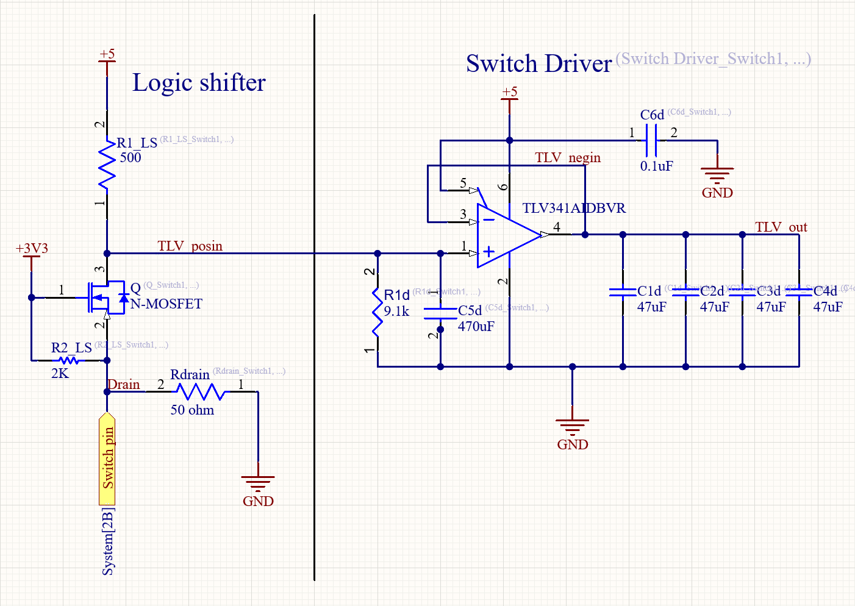
Switch driver
Logic shifter needed to convert 3.3V to 5V

Slide 12
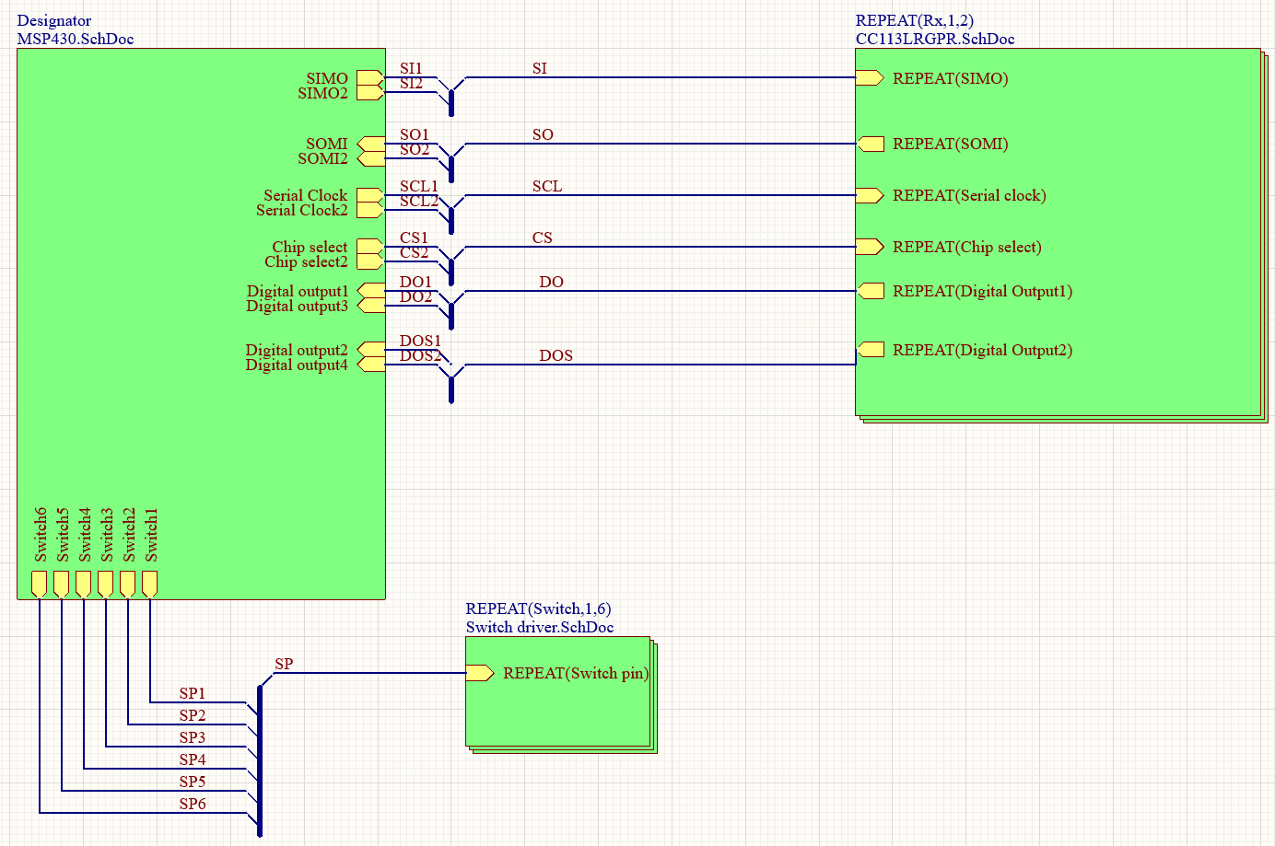
System schematic

Slide 13
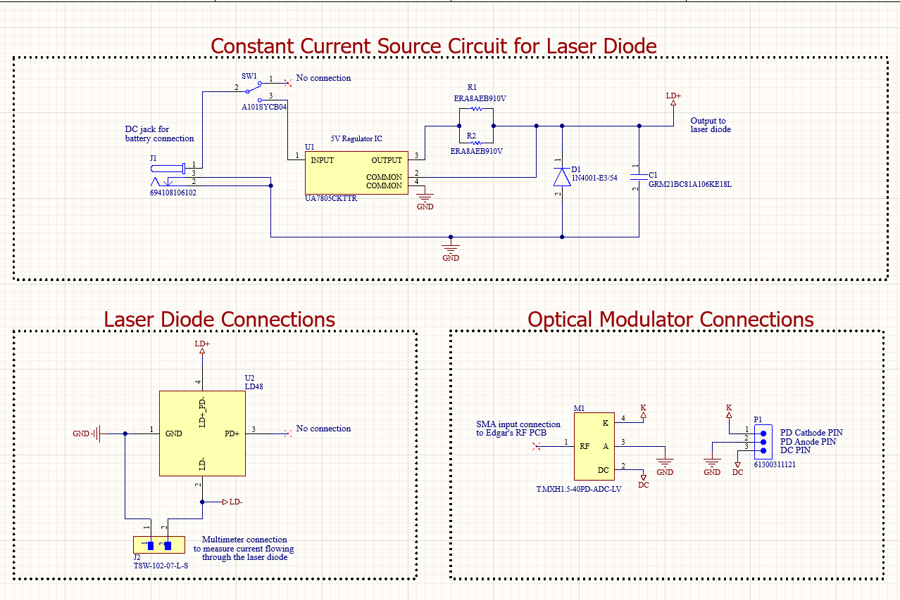
Optical Transmitter Design
A full system consisting of 3 crucial components to transmit signals over fiber optics:
A constant current source to forward bias a laser diode in to operate in continuous wave mode
An MZM modulator takes in the RF signal as an input and modulates the CW laser
The information originally carried by the RF signal, is now transferred to an optical carrier signal, and will be transmitted into a fiber optic channel.

Slide 14
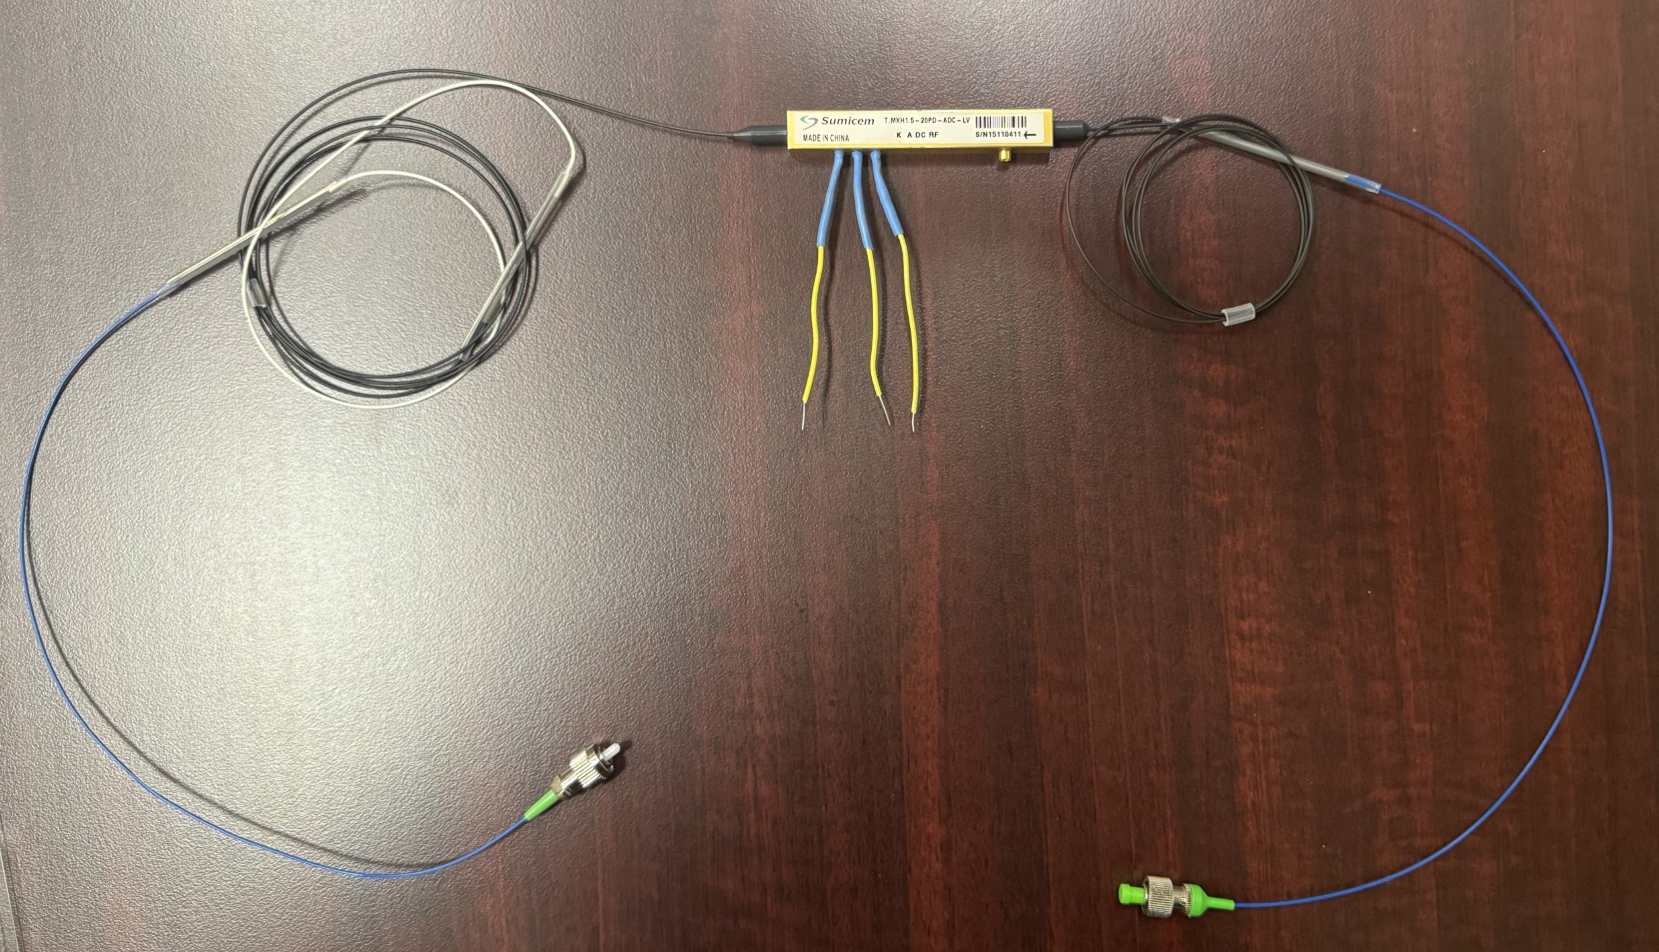
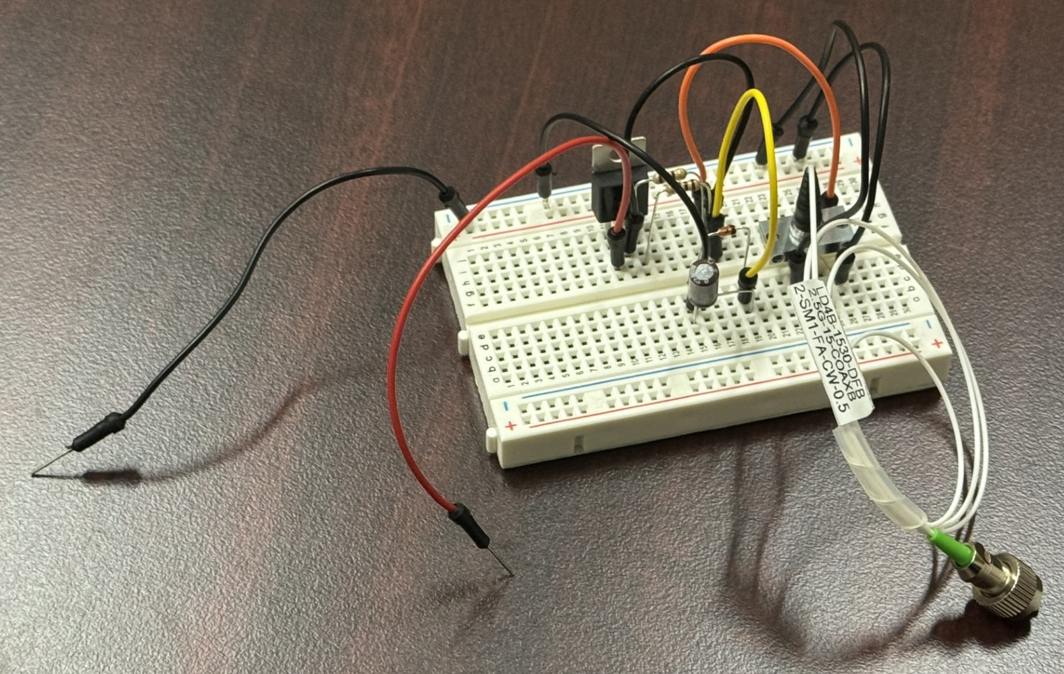
Prototype of Optical Transmitter
Laser diode and constant current source circuit all on the same breadboard
MZM modulator with jumper wires soldered onto the A,K, and DC pins

Slide 15
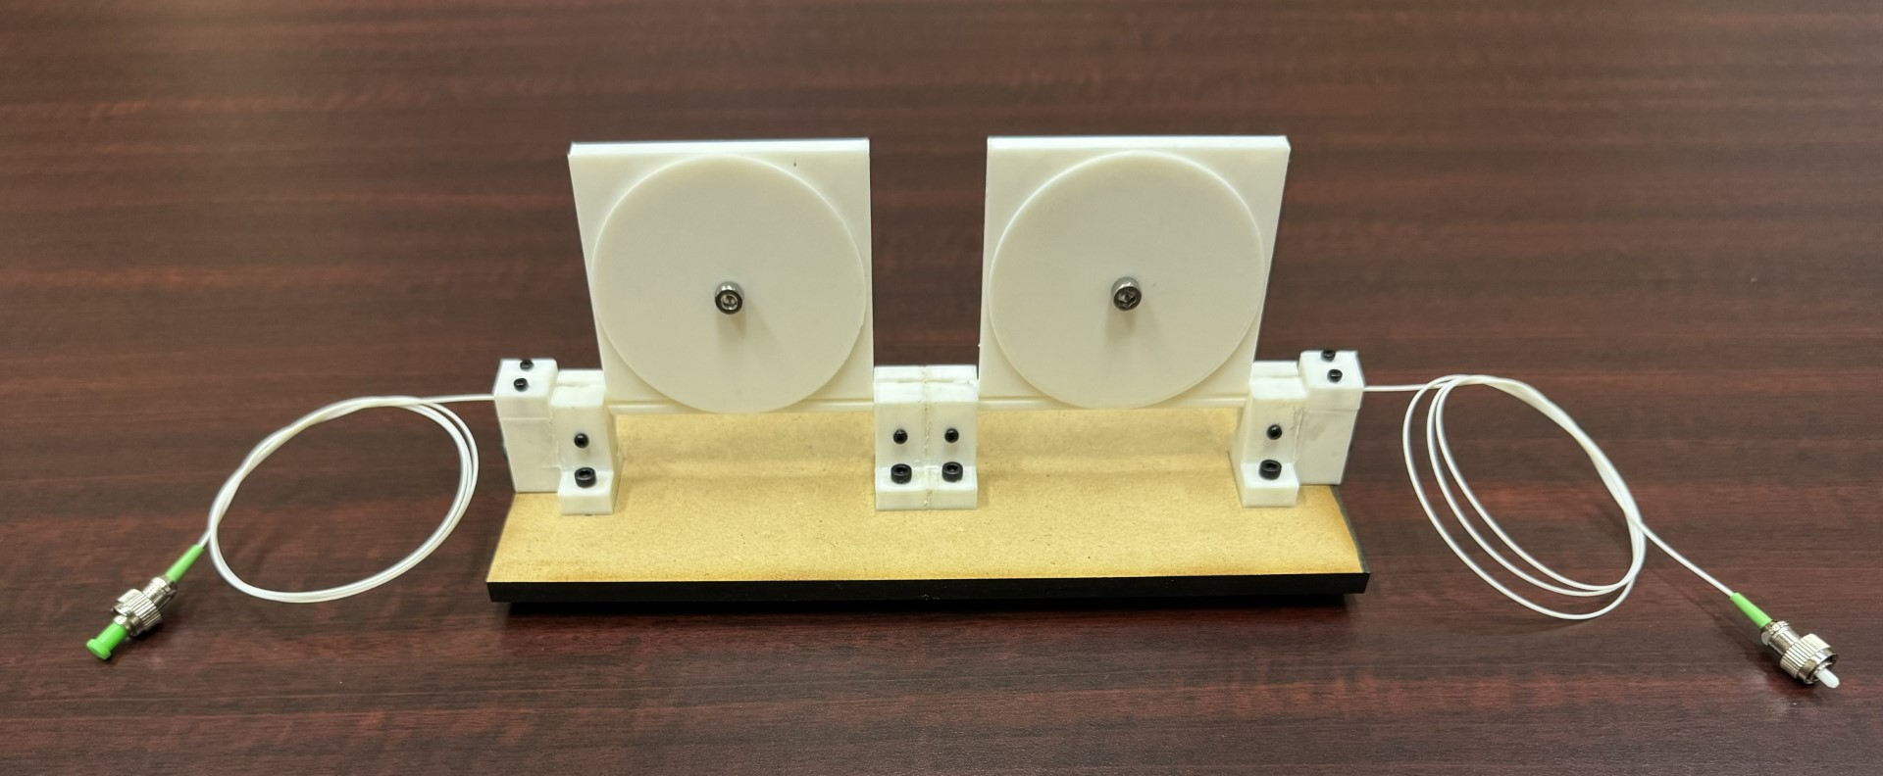
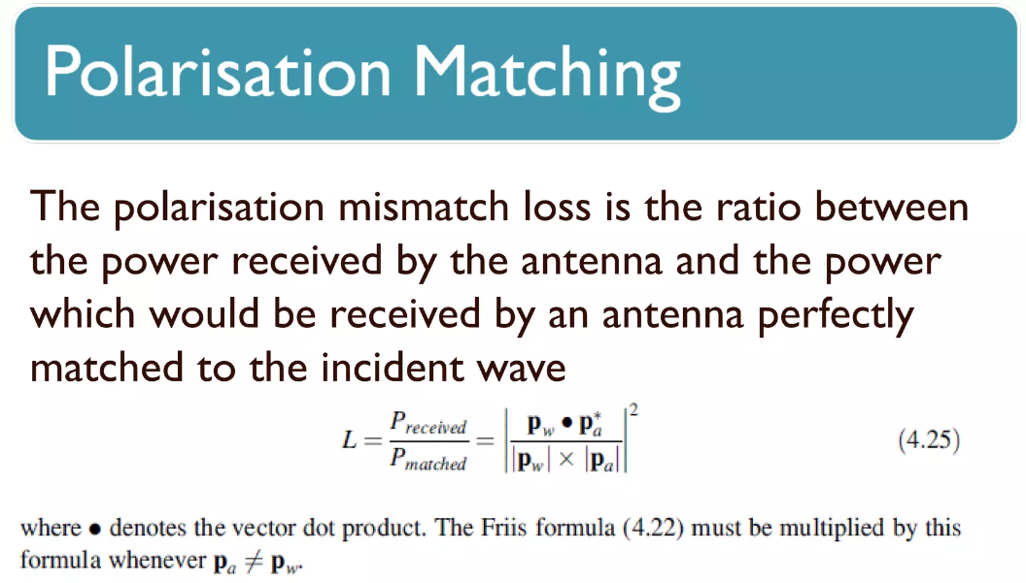
Fiber Polarization Controller
A device that converts an arbitrary input polarization state to any desired output polarization state.
Ensures that the maximum power from the laser diode is transferred to the modulator and fiber optic channel.

Slide 16

Fiber Polarization Controller (Continued)
A device that converts an arbitrary input polarization state to any desired output polarization state.
Ensures that the maximum power from the laser diode is transferred to the modulator and fiber optic channel.

Slide 17
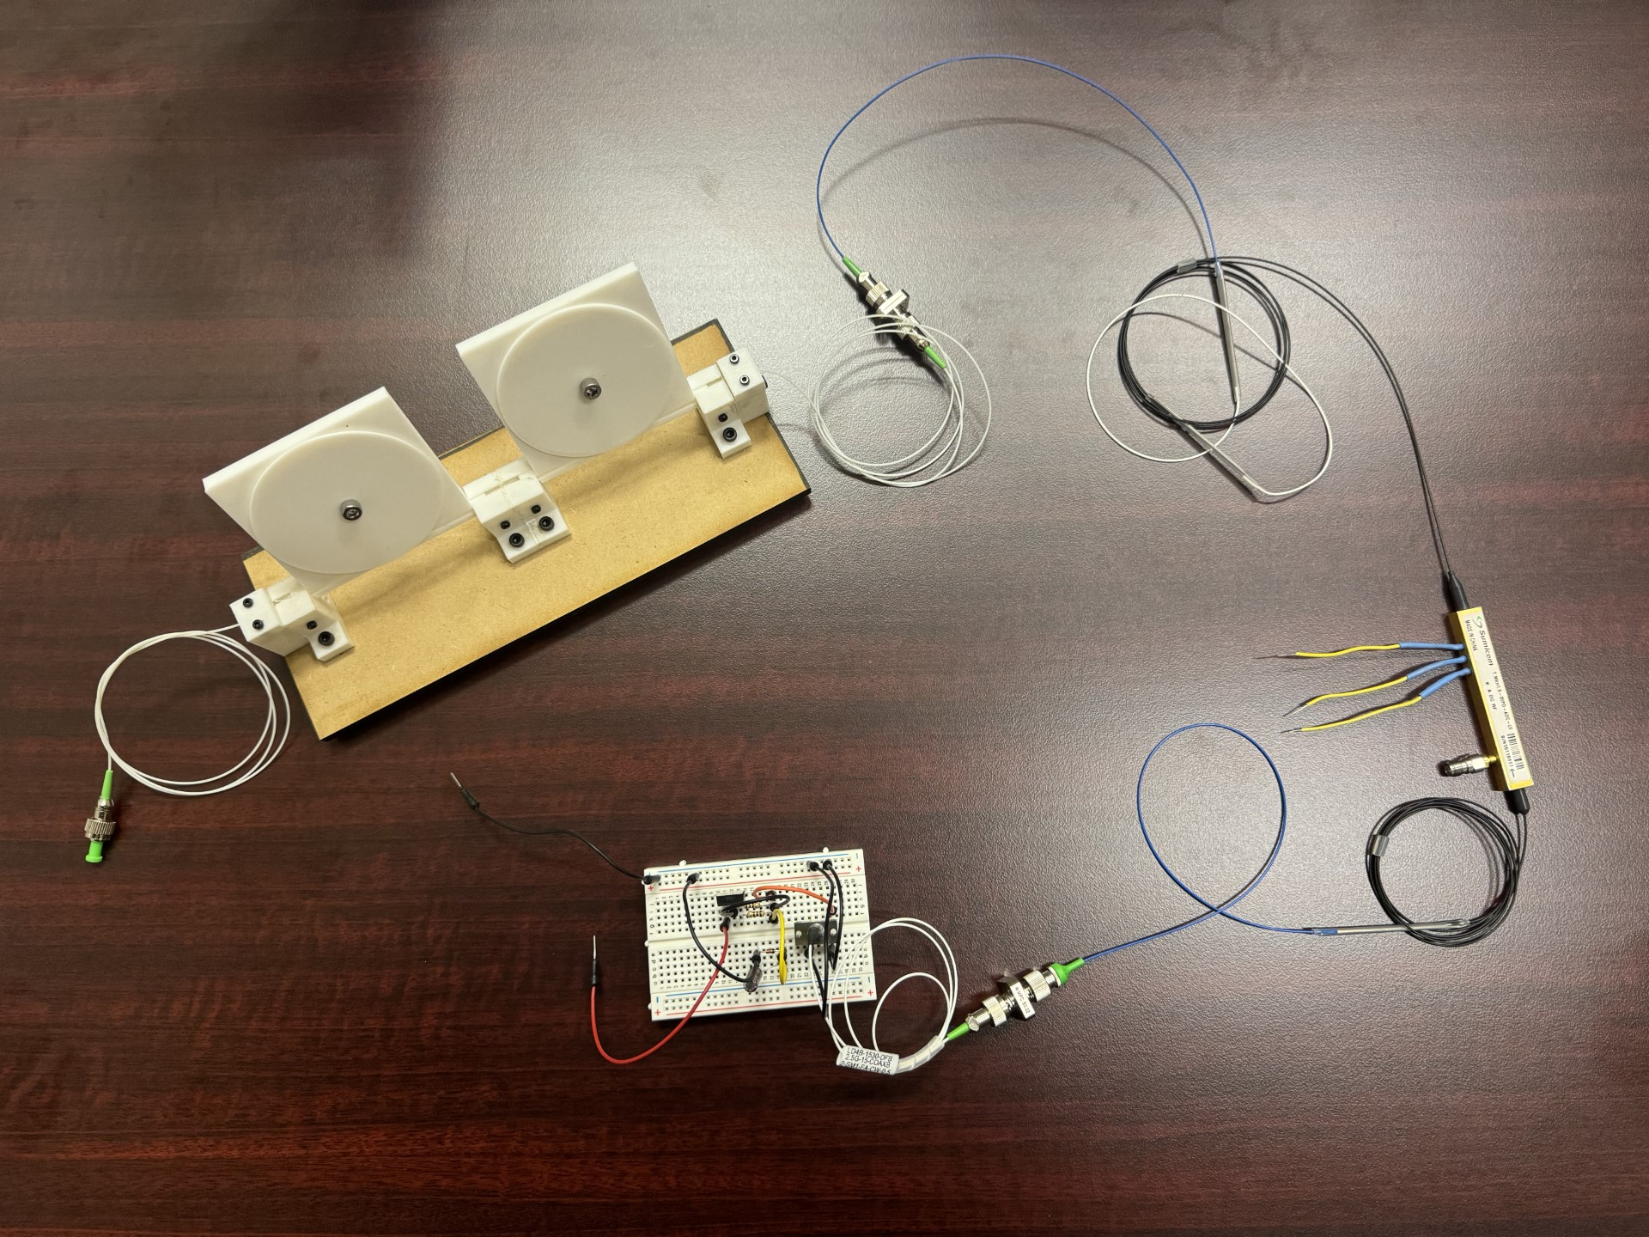
Transmitter + Controller

Slide 18
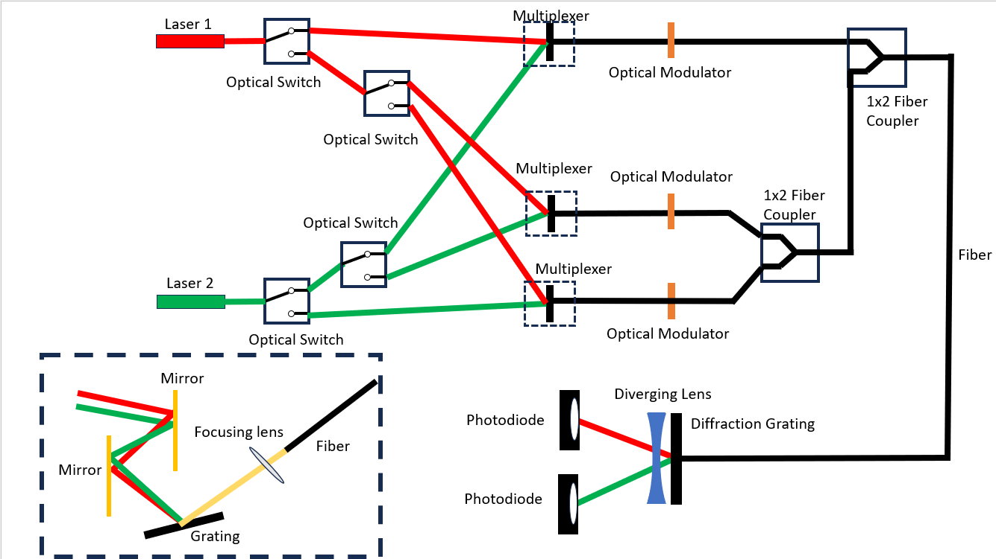
Optics Block Diagram

Slide 19
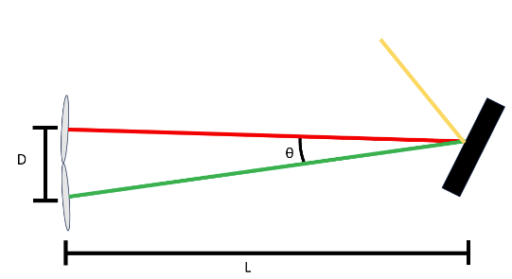
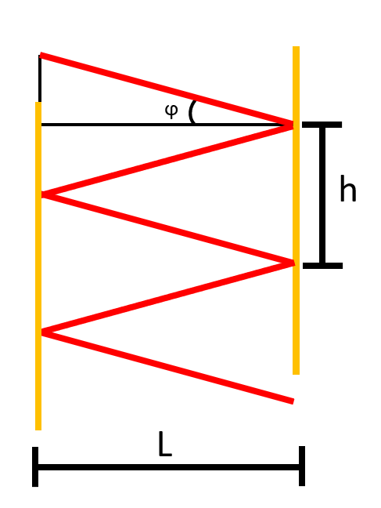
Multiplexing Design
Multiplexing is combination of different wavelengths of light
Different wavelengths experience different angles of diffraction
Even with large dispersion, angle difference is small (~3.4^{O})
Use mirror cavity to get long path length, but small device size

Slide 20
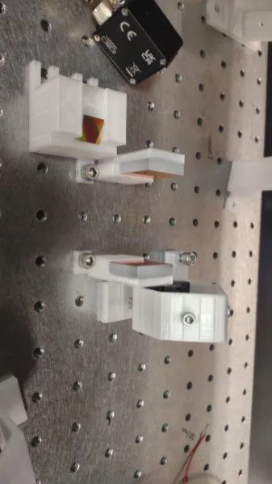
Multiplexing Design

Slide 21

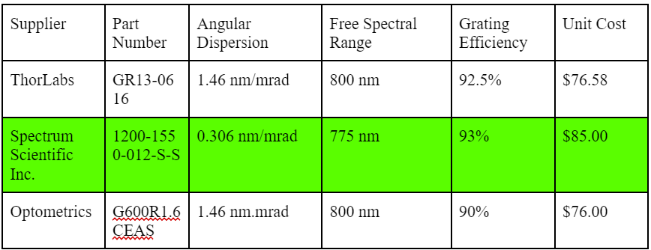
Diffractive Element Part Selection
Need to separate ~20 nm (1550-1530 nm)
Detector housing size is a design constraint
Requires strong dispersion
Use diffraction grating rather than prism
Designed a diffraction grating + mirror cavity system

Slide 22
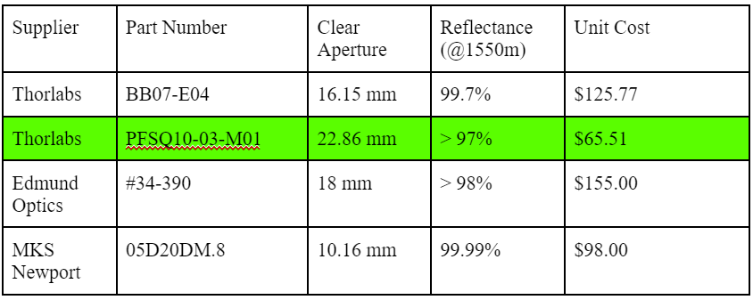
Mirror Part Selection
Require low losses
Must be balanced with cost
Clear aperture must be large enough to fit both beams

Slide 23
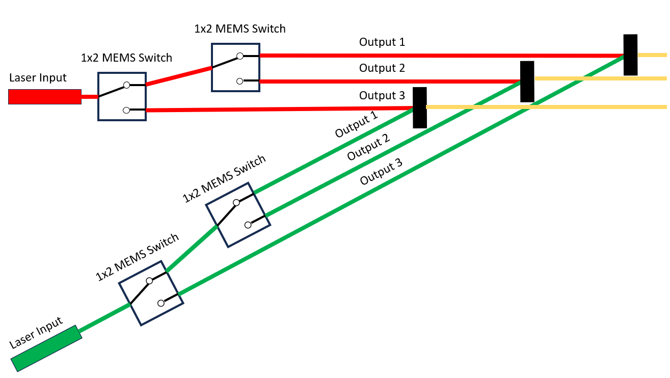
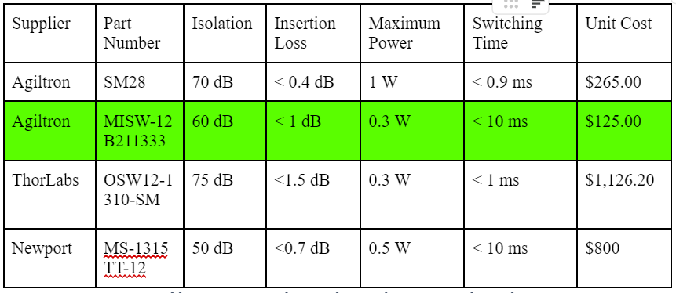
MEMS Optical Switch Part Selection
MEMS device switches fiber to 1 of 2 output ports
Will combine 1x2 switches to create switching subsystem
Need two 1x3 switches, one for each laser
Need high isolation to minimize crosstalk

Slide 24
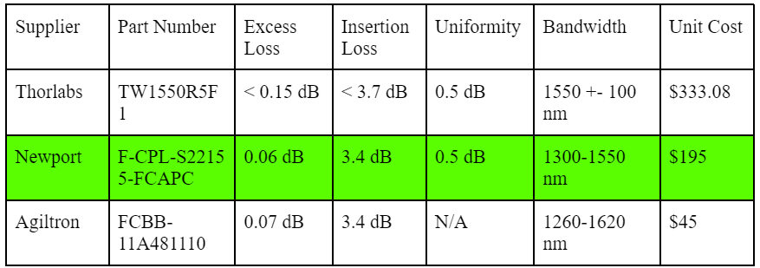
2x1 Fiber Coupler Part Selection
Need to combine outputs of all three modulators
All signal propagate through transmission fiber together
Requires fiber couplers
Need low loss coupling
Excess loss is true “loss”
Insertion loss is not truly lost
Uniformity unimportant, calibration
Agiltron has >6 week lead time

Slide 25
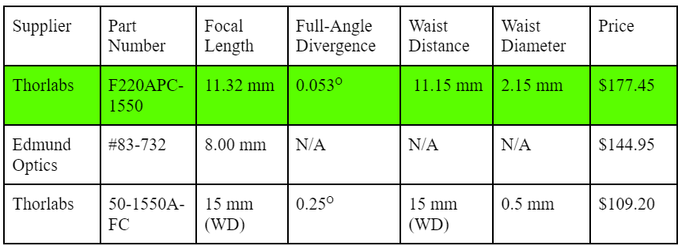
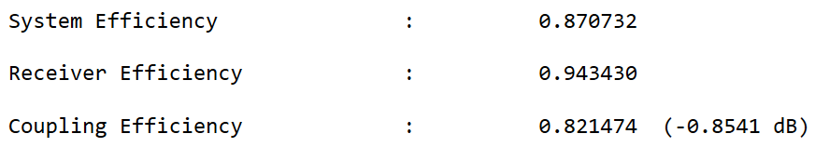
Fiber Collimator/Focusing Lens Selection
Diffraction gratings are free space components
Require fiber-free space-fiber coupling
Will utilize collimating lenses that couple to fiber connectors
Need long distance transmission, i.e. small divergence angle
Waist diameter must be smaller than detector size (3mm)
Must balance loss and spot size
Simulated in Zemax
< 1 dB loss

Slide 26
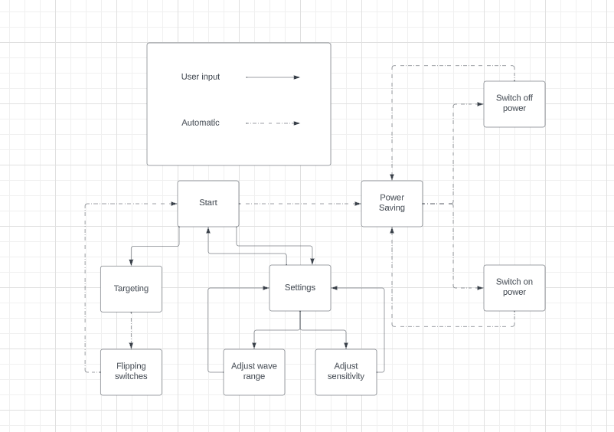
Software Block Diagram

Slide 27
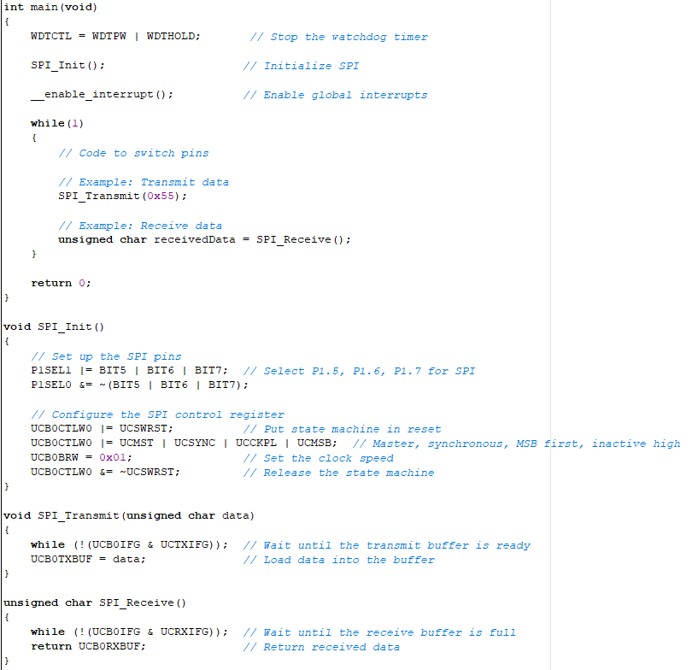
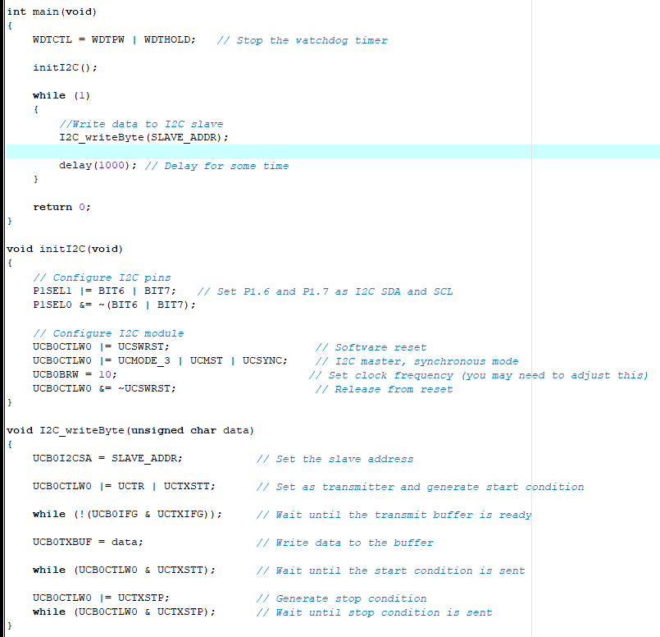
Coding
SPI Code
I2C Code

Slide 28
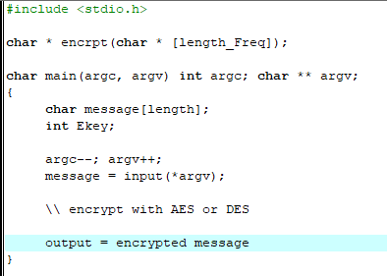
Encryption

Slide 29
Standards
ITU G 694.1/694.2 (CWDM and DWDM standards)
ITU G.9803 (RFoF)
IEC 60825-1 (Laser safety classes)
ANSI Z136 (Laser safety precautions)
Coding Standards
Encryption Standards

Slide 30
Design Constraints
Economic
Time
Modulation Scheme
Environment
Societal
Political
Ethic
Health
Safety
Manufactuability
Sustainability

Slide 31
Bill of Materials/Budget
Item | Supplier | Part Number | Unit Price | Quantity | Estimated Price
Mach-Zehnder Modulator | Sumicem | T.MXH1.5-40PD-ADC-LV | $249.99 | 2 | $499.98
Single Mode Optical Fiber | Thorlabs | SM-28 | $0.6144/m | 100 m | $61.44
Laser Diodes | Laser Diode Source Laser Diode Source | LDI-1550-DFB-2.5G-20/70-B-2-SM1-FA-CW-0.5 LDI-1530-FP-1.25G-15/50-B-2-SM1-FA-CW | $415.00 $315.00 | 1 1 | $415.00 $315.00
Photodiodes | Thorlabs | DET08CL | $319.11 | 2 | $638.22

Slide 32
Bill of Materials/Budget Cont.
Diffraction Grating | Spectrum Scientific Inc. | 1200-1550-012-S-S | $85.00 | 4 | $340.00
Collimating Lens UPC | Thorlabs | F260FC-1550 | $177.45 | 4 | $532.35
Collimating Lens APC | Thorlabs | F260APC-1550 | $240.45 | 6 | $1442.7
Kinematic Mount | Thorlabs | KM05 | $42.18 | 11 | $463.98
Mirror | Thorlabs | PF10-03-M01 | $56.26 | 6 | $337.56
Fiber Coupler | Newport | F-CPL-S22155-FCAPC | $195.00 | 2 | $390.00
Optical Switch | Agiltron | MISW-12B211333 | $125.00 | 4 | $500.00
RF Transceiver Options | Great Scott Gadgets Texas Instruments | HackRF one CC113LRGPR | $344.95 $1.8 | 1 3 | $344.95 $5.4

Slide 33
Bill of Materials/Budget Cont.
Microcontroller Development Board | Texas Instruments | msp430fr6989 | $20 | 1 | $20.00
PCB Fabrication | JLCPCB | TBD | TBD | 6 | TBD
Housing Materials | TBD | TBD | TBD | TBD | TBD
Total Budget: |  | TBD

Slide 34
Work Distribution
RF and MCU | Antenna Selection | Edgar | Francisco
 | Receiver Implementation | Edgar | Francisco
 | RF Testing | Edgar | Francisco
Laser Diodes | Hardware Selection | Francisco | Justin
 | Hardware Design | Francisco | Justin
 | Testing | Francisco | Justin
Photodiodes | Hardware Selection | Francisco | Justin
 | Hardware Design | Francisco | Justin
 | Testing | Francisco | Justin
Encryption | Software Design | James | Francisco
 | Testing | James | Francisco
Subsystem | Task | Assignee | Secondary
Optical Switching | Hardware Selection | Justin | Francisco
 | PCB Design | Francisco | Justin
 | PCB Test | Francisco | Justin
 | Software Design | James | Justin
 | Software Test | James | Justin
MUX/DEMUX | Hardware Design | Justin | Francisco
 | Alignment | Justin | Francisco
 | Testing | Justin | Francisco
Fiber | Hardware Selection | Justin | Francisco
 | Testing | Justin | Francisco

Slide 35
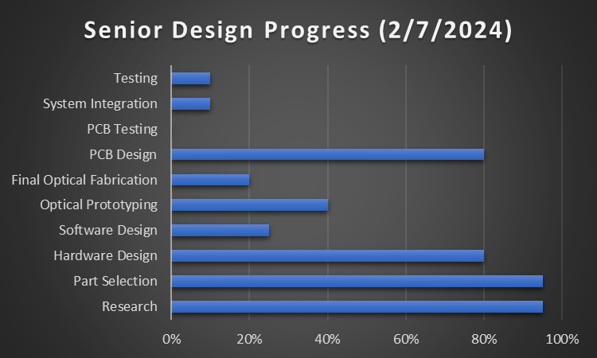
Progress

